Slide 1
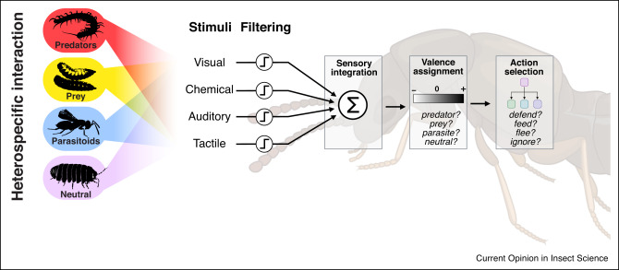
Introduction
Upon encountering another species, what are they “thinking”?
What is the most fundamental way we can answer this question?
Complex vs. Simple statistical methods?

Slide 2
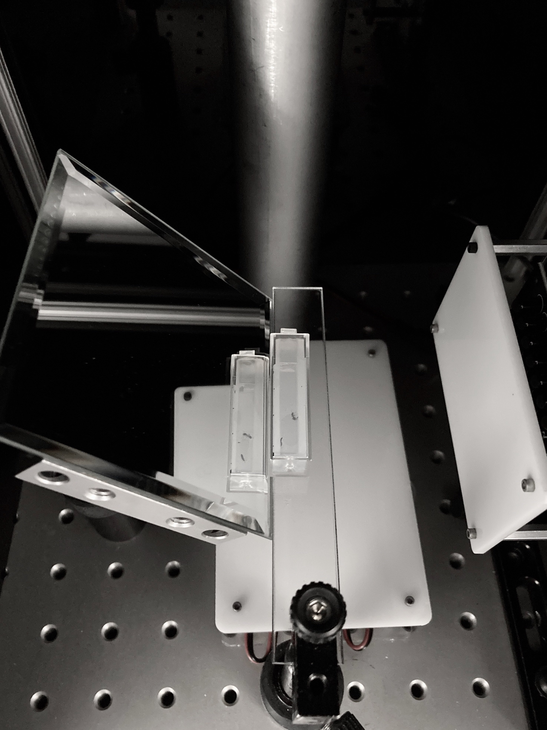
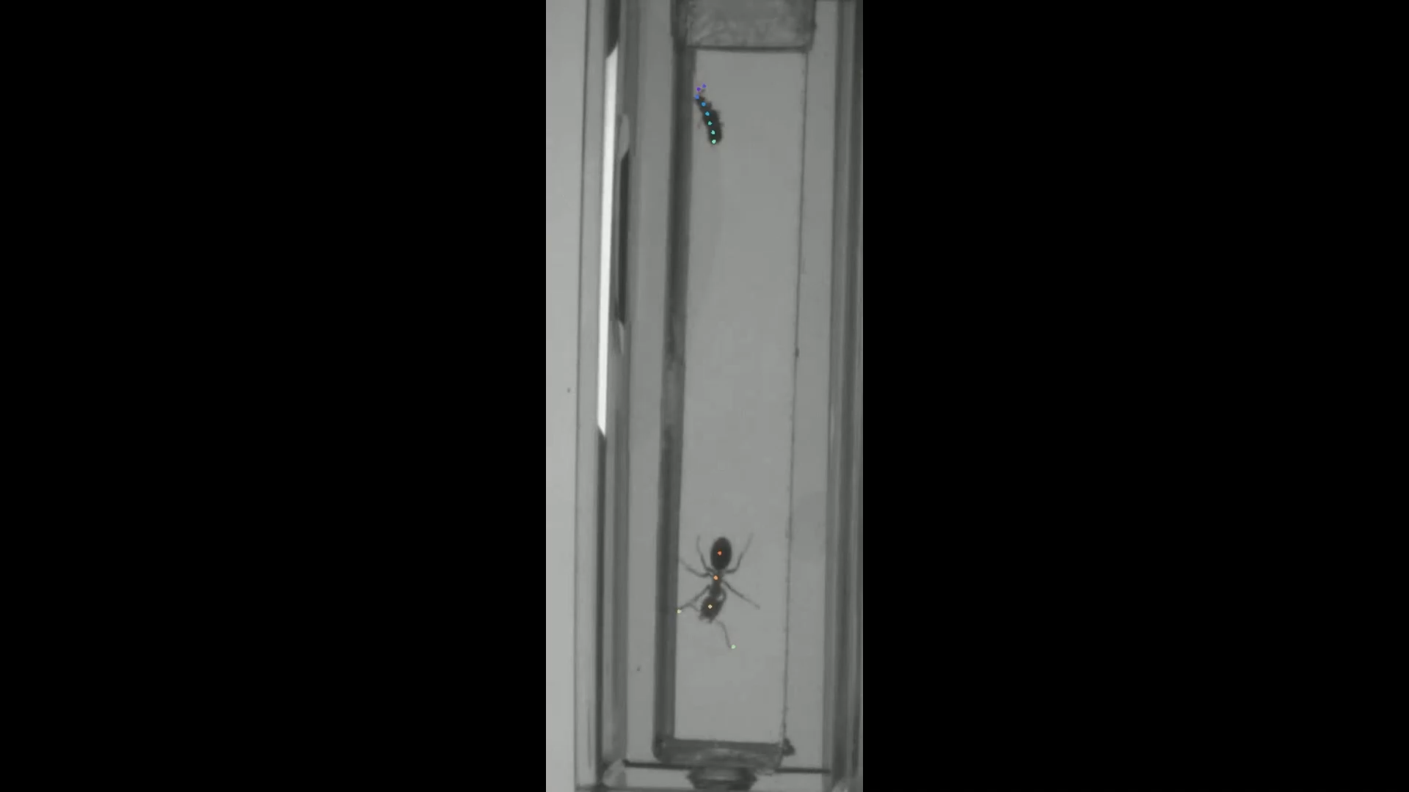
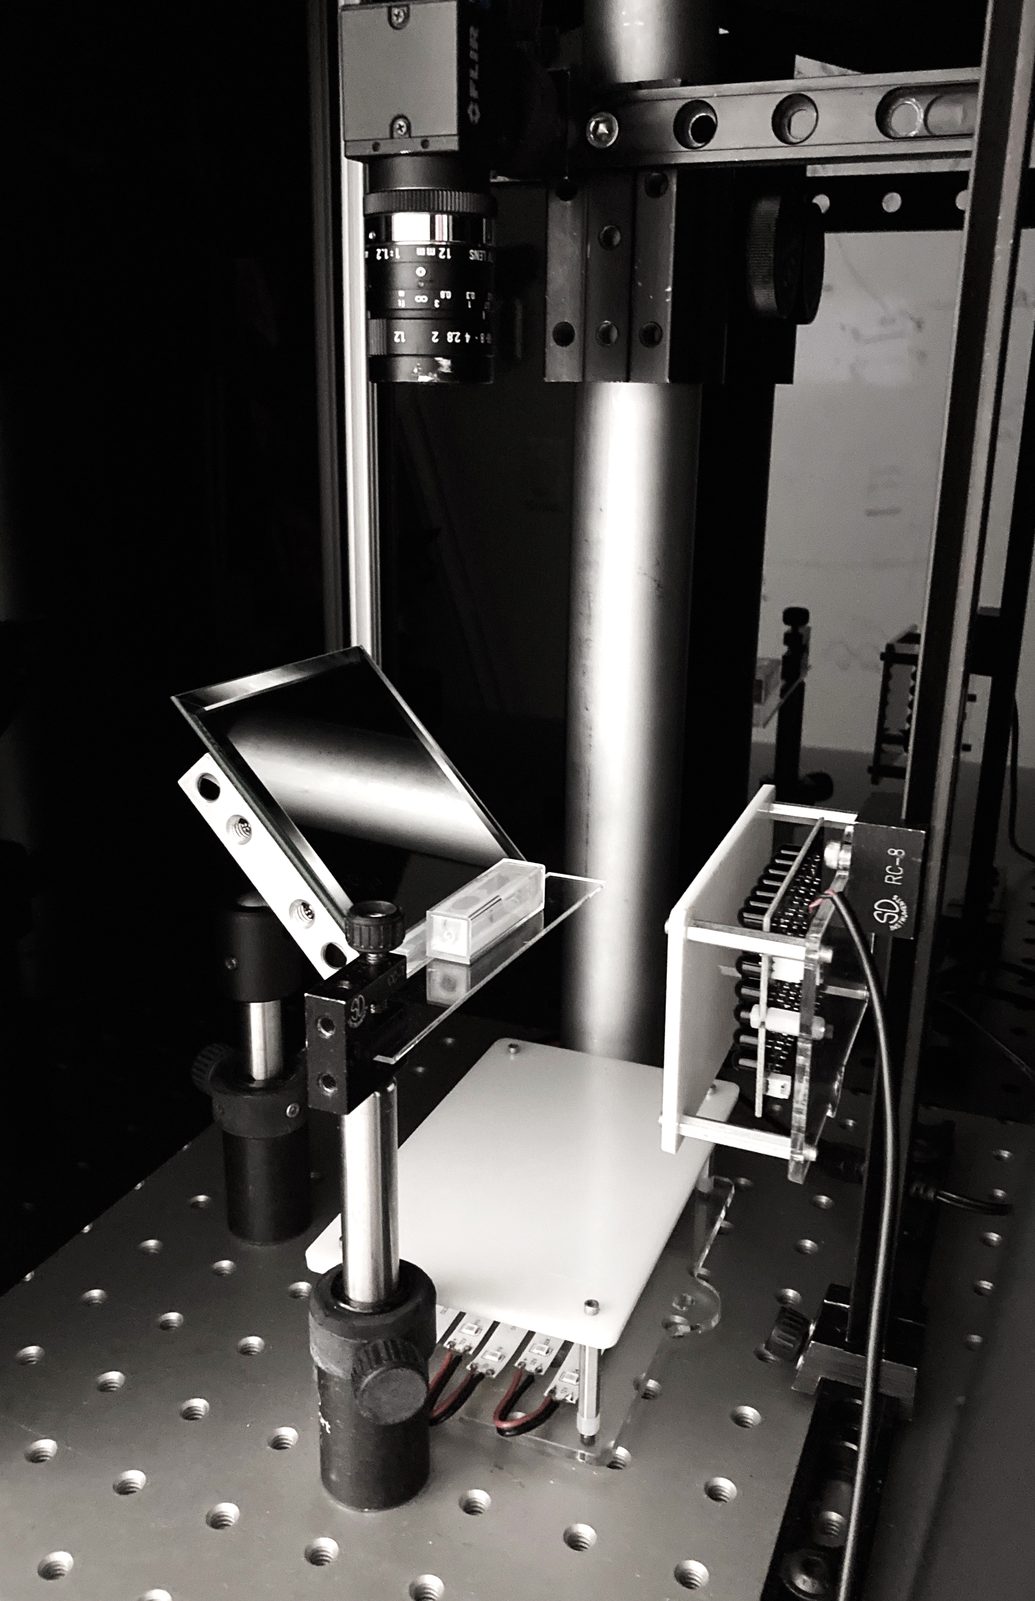
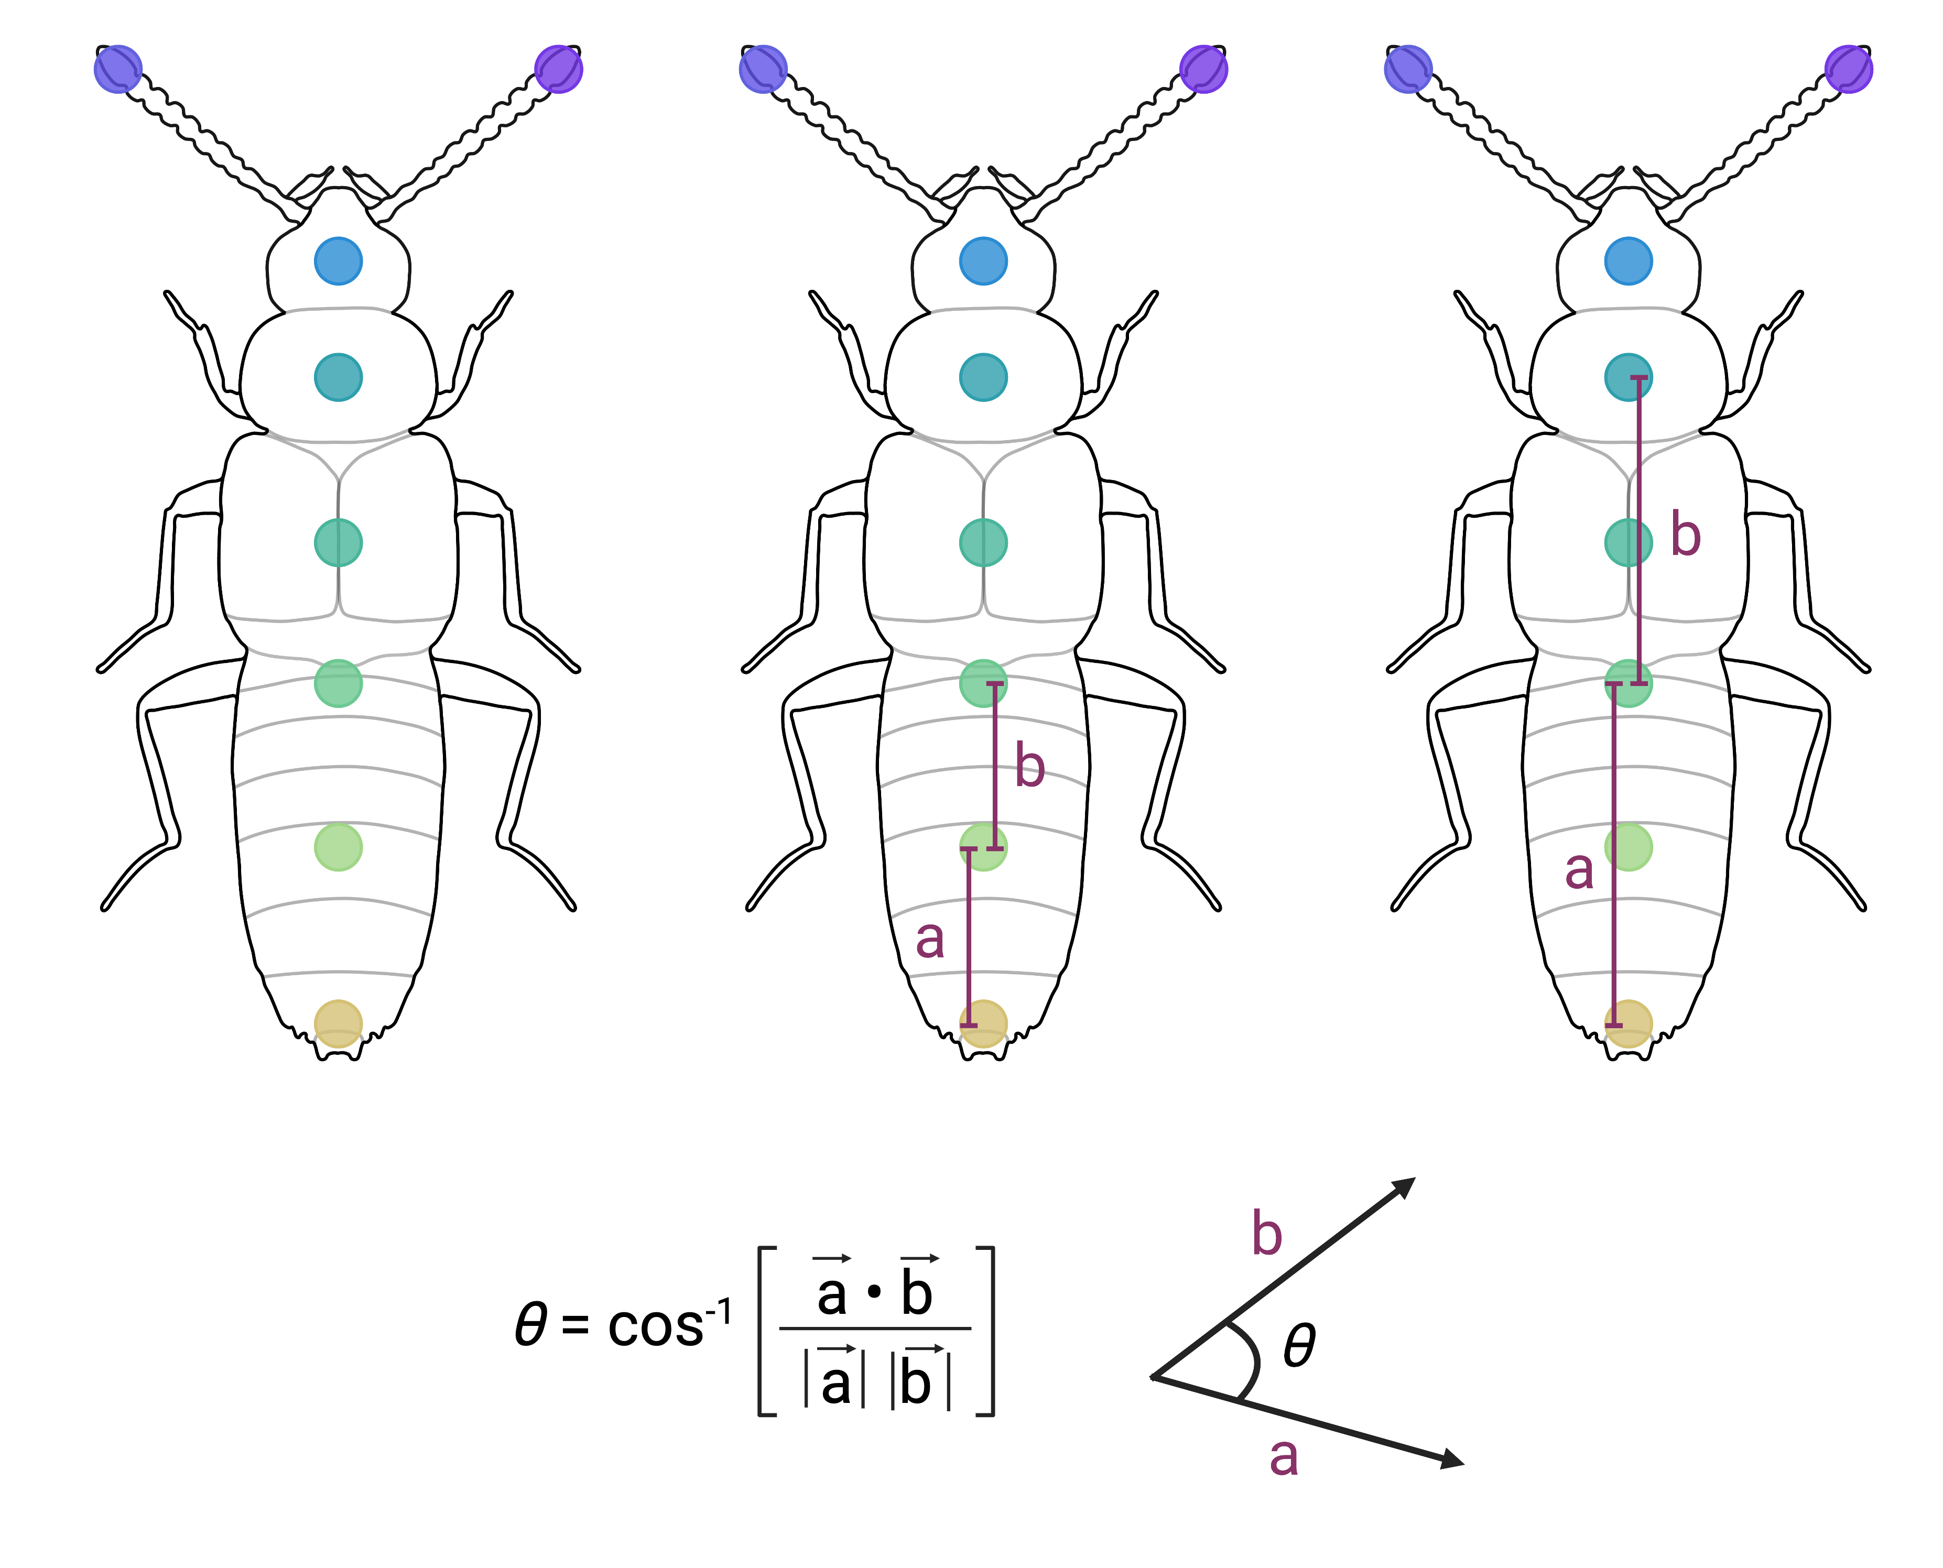
Setup
camera view
IR
camera
mirror capturing side view reflection
behavior chamber
IR LED boards & diffusers

Slide 3
Big Picture Questions
With that in mind, we can more concretely ask…
How does Dalotia respond to threats?
What features of an approaching insect help it make such decisions?
What senses are involved?
Most importantly: how can we extract this from unstructured videos?
Notes:
Something along the lines of…
How does Dalotia respond to danger/threat?
What features and/or sensory systems does Dalotia use to make behavioral decisions of how to respond?

Slide 4
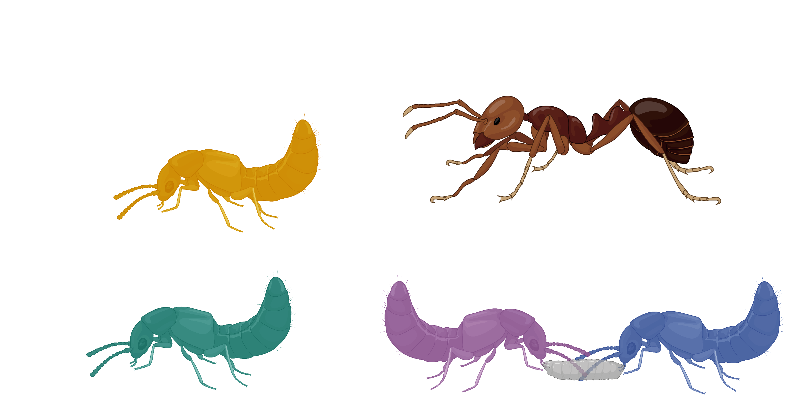
Framework: Defining Key Metrics
Velocity: Distance travelled between two frames, divided by time elapsed.
Frame 2
( + 0.1667 seconds)
Frame 1

Slide 5
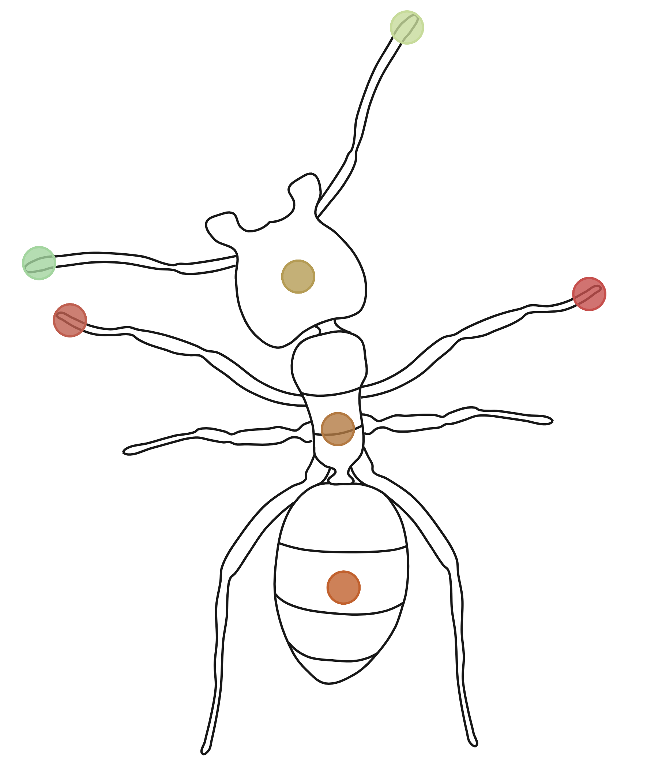
Framework: Defining Key Metrics
Interaction: When the foreign species enters and remains in a
radius of the beetle. This radius is 125 pixels unless otherwise specified.
125 pixels
Interaction!
Notes:
WHY 125 YOU MAY ASK?

Slide 6
Framework: Defining Key Metrics
Approach Speed: The average velocity of the foreign species 10 frames before an interaction.
125 pixels
Interaction!

Slide 7
Framework: Defining Key Metrics
Orientation: The distance between Dalotia head and the foreign species' midsection, subtracted from the distance between Dalotia mid – Foreign mid. Averaged 60 frames before interaction
Why?
Negative Orientation, “Facing Away”

Slide 8
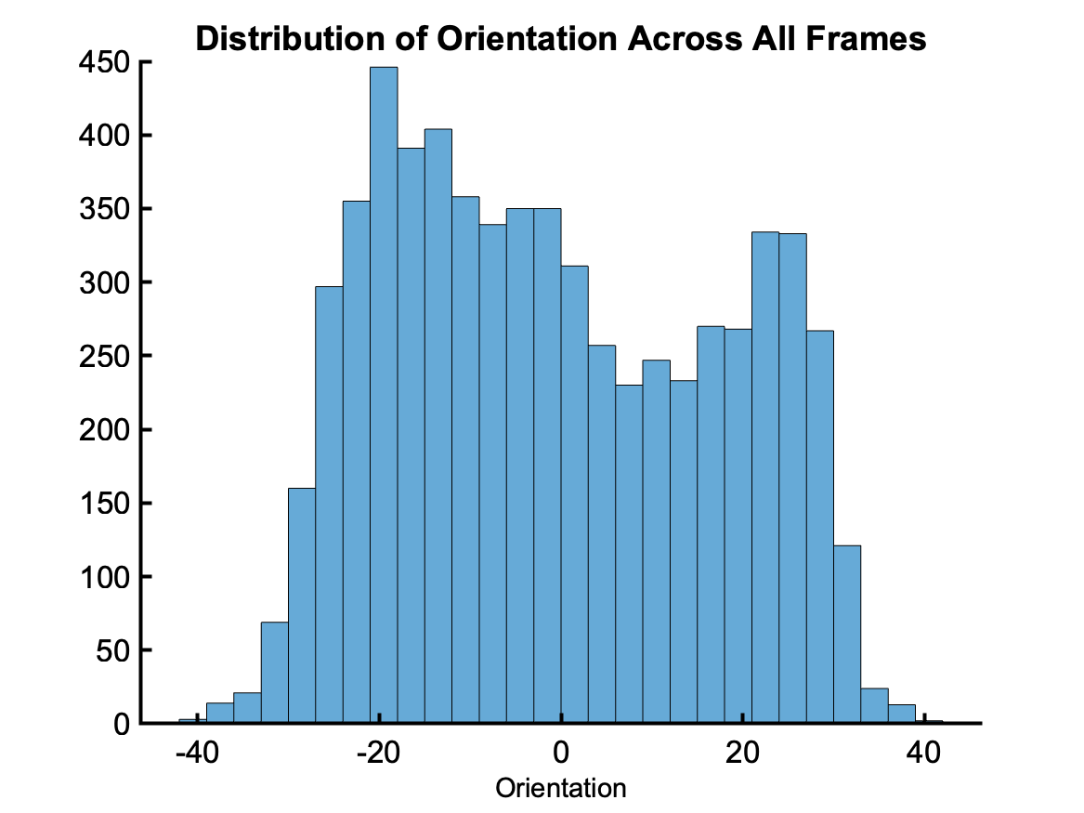
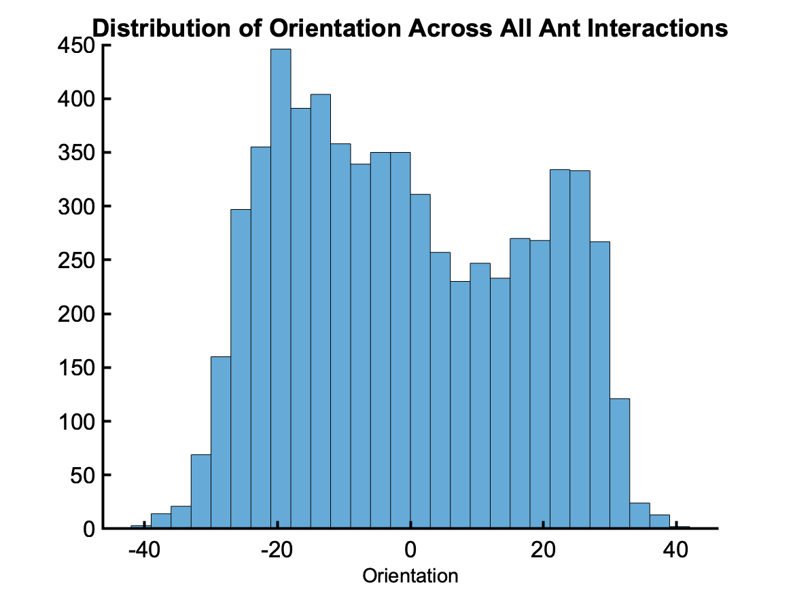
Framework: Defining Key Metrics

Slide 9
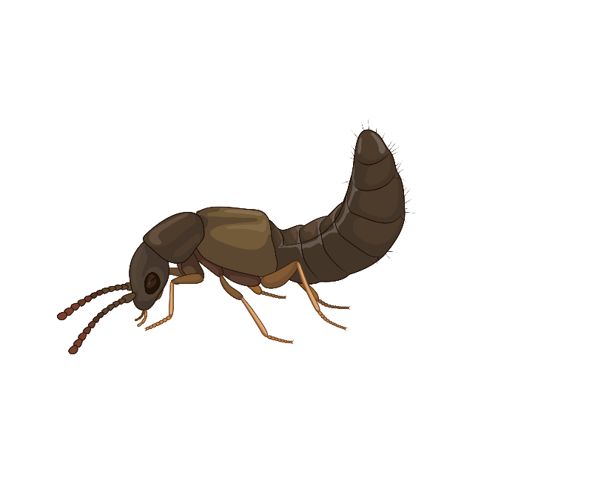
Framework: Defining Key Metrics
Flex Angle : Angle formed by Dalotia Elytra, Abdomen 1, and Abdomen 3

Slide 10
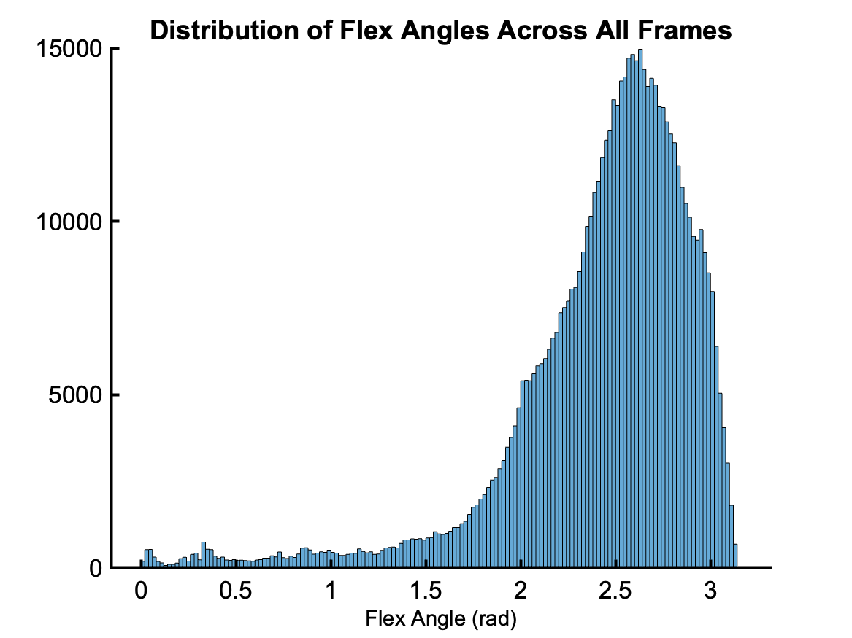
Framework: Defining Key Metrics

Slide 11
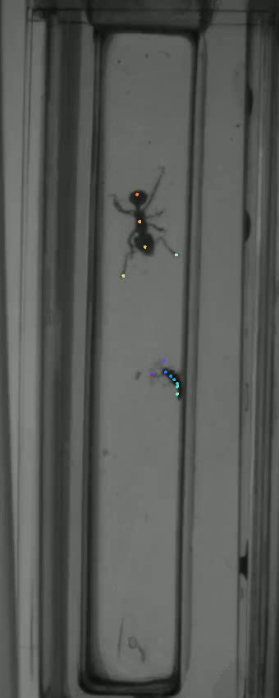
Defining Interaction Responses
Flex Response: The minimum angle flexed by the beetle during the interaction is less than 100 degrees.
Notes:
Define threat response:
To flex, flee, or both
Flex = …
Flee = …
Both = …
Alternatively, dal may perform none of above
Neither = …
Add some diagrams to visually depict response types (or short video clips)

Slide 12
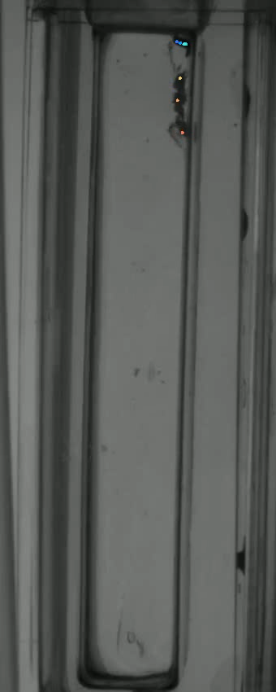
Defining Interaction Responses
Flee Response: After the interaction, the beetle’s escape velocity was over 20000 pixels per minute.
Notes:
Define threat response:
To flex, flee, or both
Flex = …
Flee = …
Both = …
Alternatively, dal may perform none of above
Neither = …
Add some diagrams to visually depict response types (or short video clips)

Slide 13
Defining Interaction Responses
Flex - Flee Response: The requirements of both a flex and flee response are met.
Neither Response: The requirements of neither a flex nor flee response are met.
Notes:
Define threat response:
To flex, flee, or both
Flex = …
Flee = …
Both = …
Alternatively, dal may perform none of above
Neither = …
Add some diagrams to visually depict response types (or short video clips)

Slide 14
Reaction Flowchart
Use orientation and approach Speed as proxies for sensory inputs
Sensory Inputs: Speed, Size, Chemical Cues, etc.
Dalotia
Threat Response
Neutral Response
Flex
Flee
Flex-Flee

Slide 15
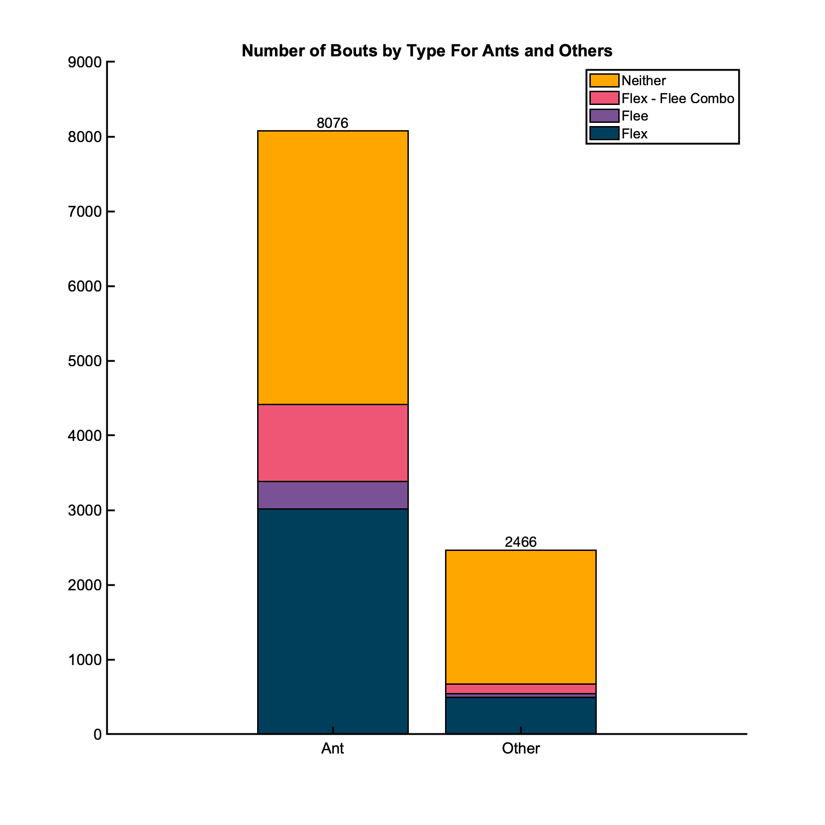
A Greater Proportion of Ant Interactions Involve Threat Responses Compared to Others

Slide 16
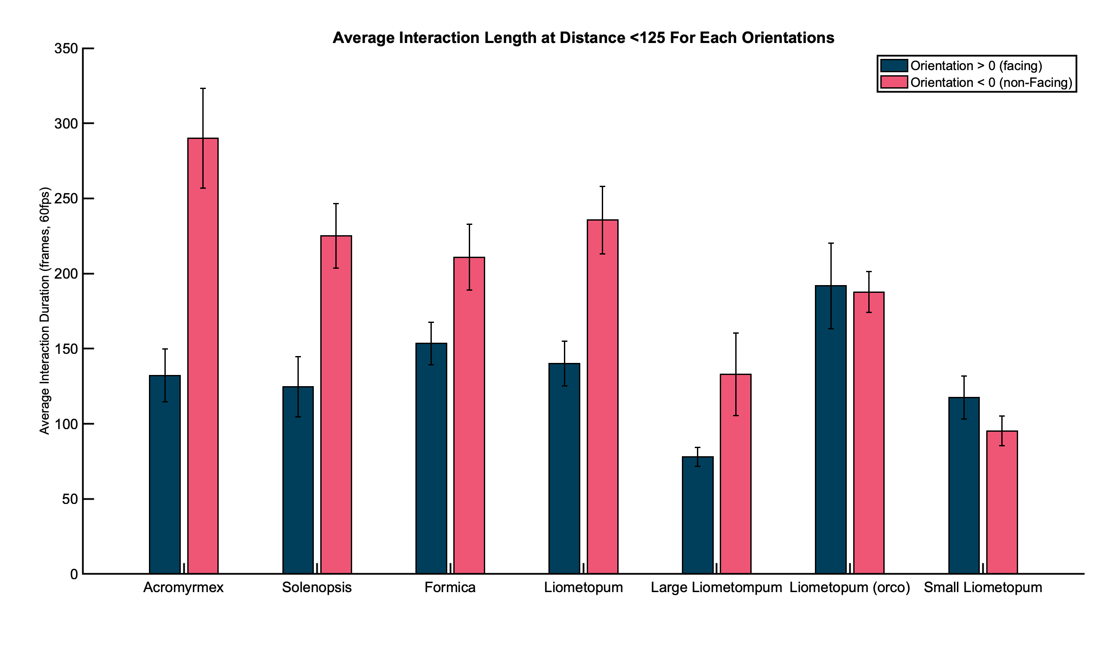
Negative Orientation tends to Lengthen Interactions for Wild Type Dalotia with Ants
Notes:
Might ask ”is this due to smth inherent about the ants, or is it simply an association created by repeated encounters?”
Answers: Not enough data since there’s only one “first encounter” per video; furthermore, most videos don’t have enough encounters to truly observe habituation.
Or, simply pass on to Jess, as her experiments more directly address this topic.

Slide 17
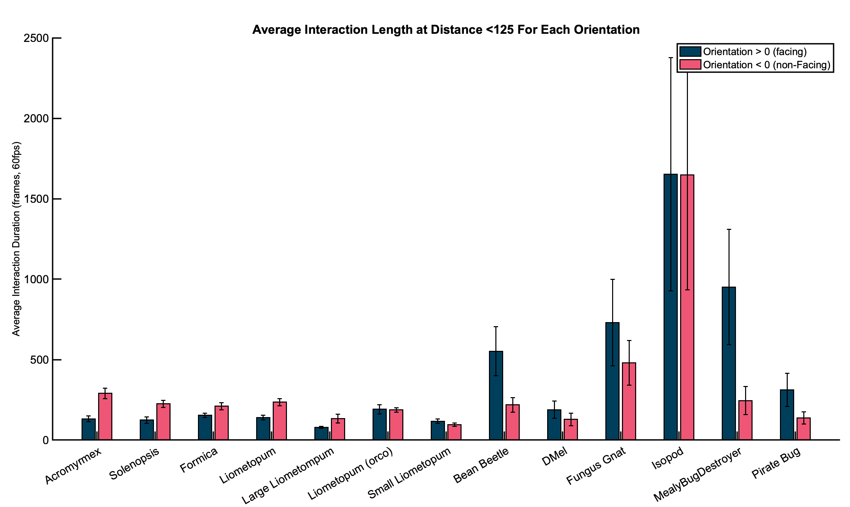
The opposite appears to be true for Non-Ant species

Slide 18
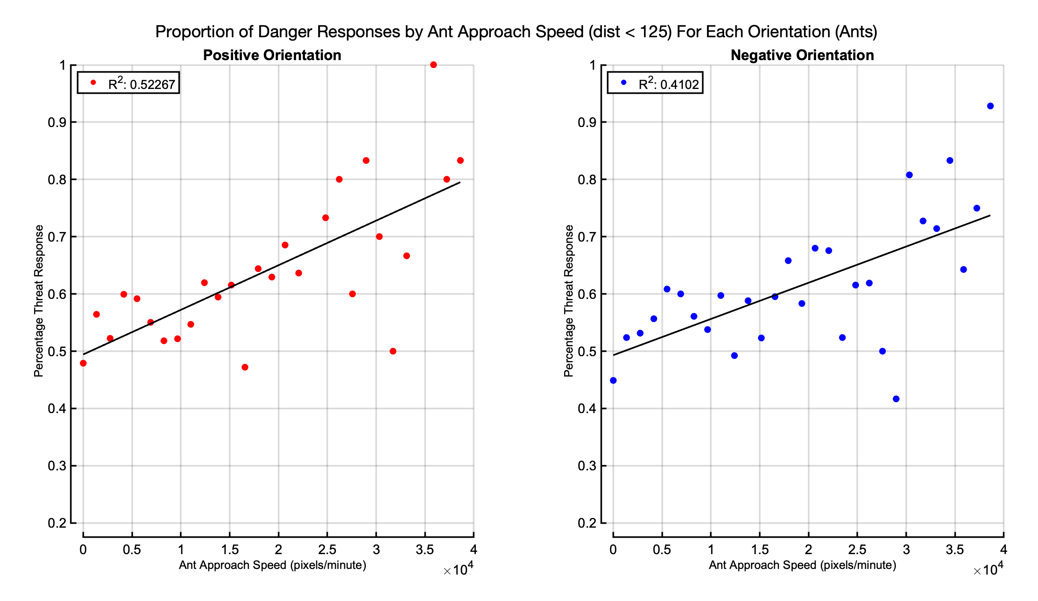
Proportion of Threat Responses Increases With Ant Approach Speed
Proportion of Threat

Slide 19
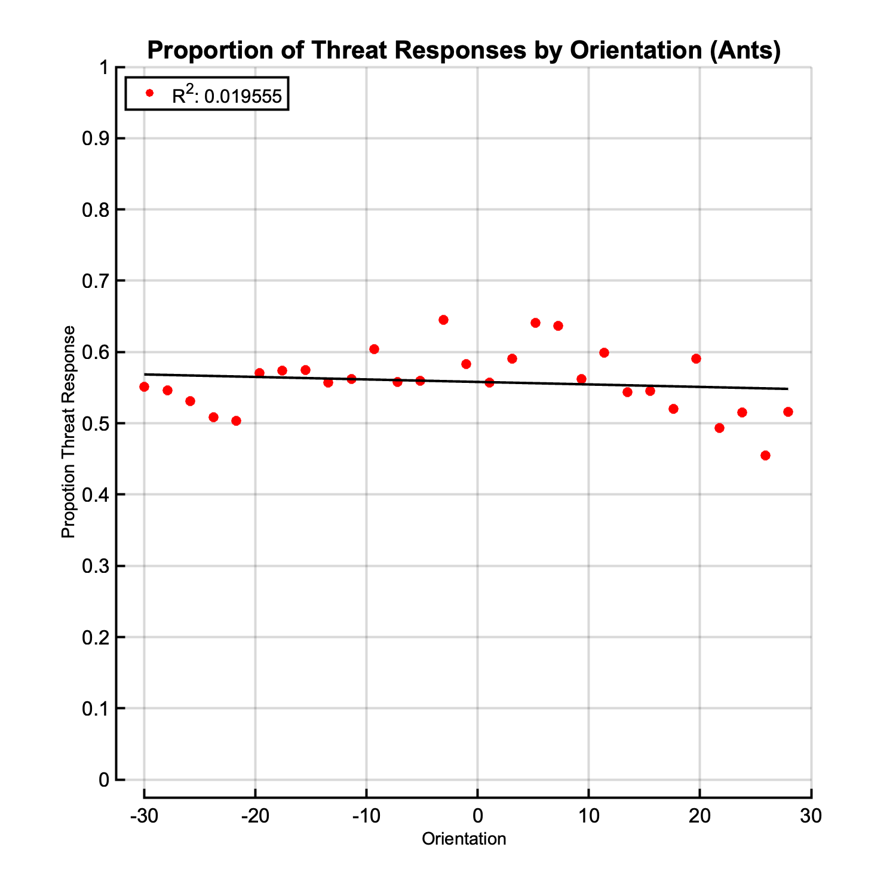
Proportion of Threat Responses Doesn’t Correlate With Beetle Orientation

Slide 20
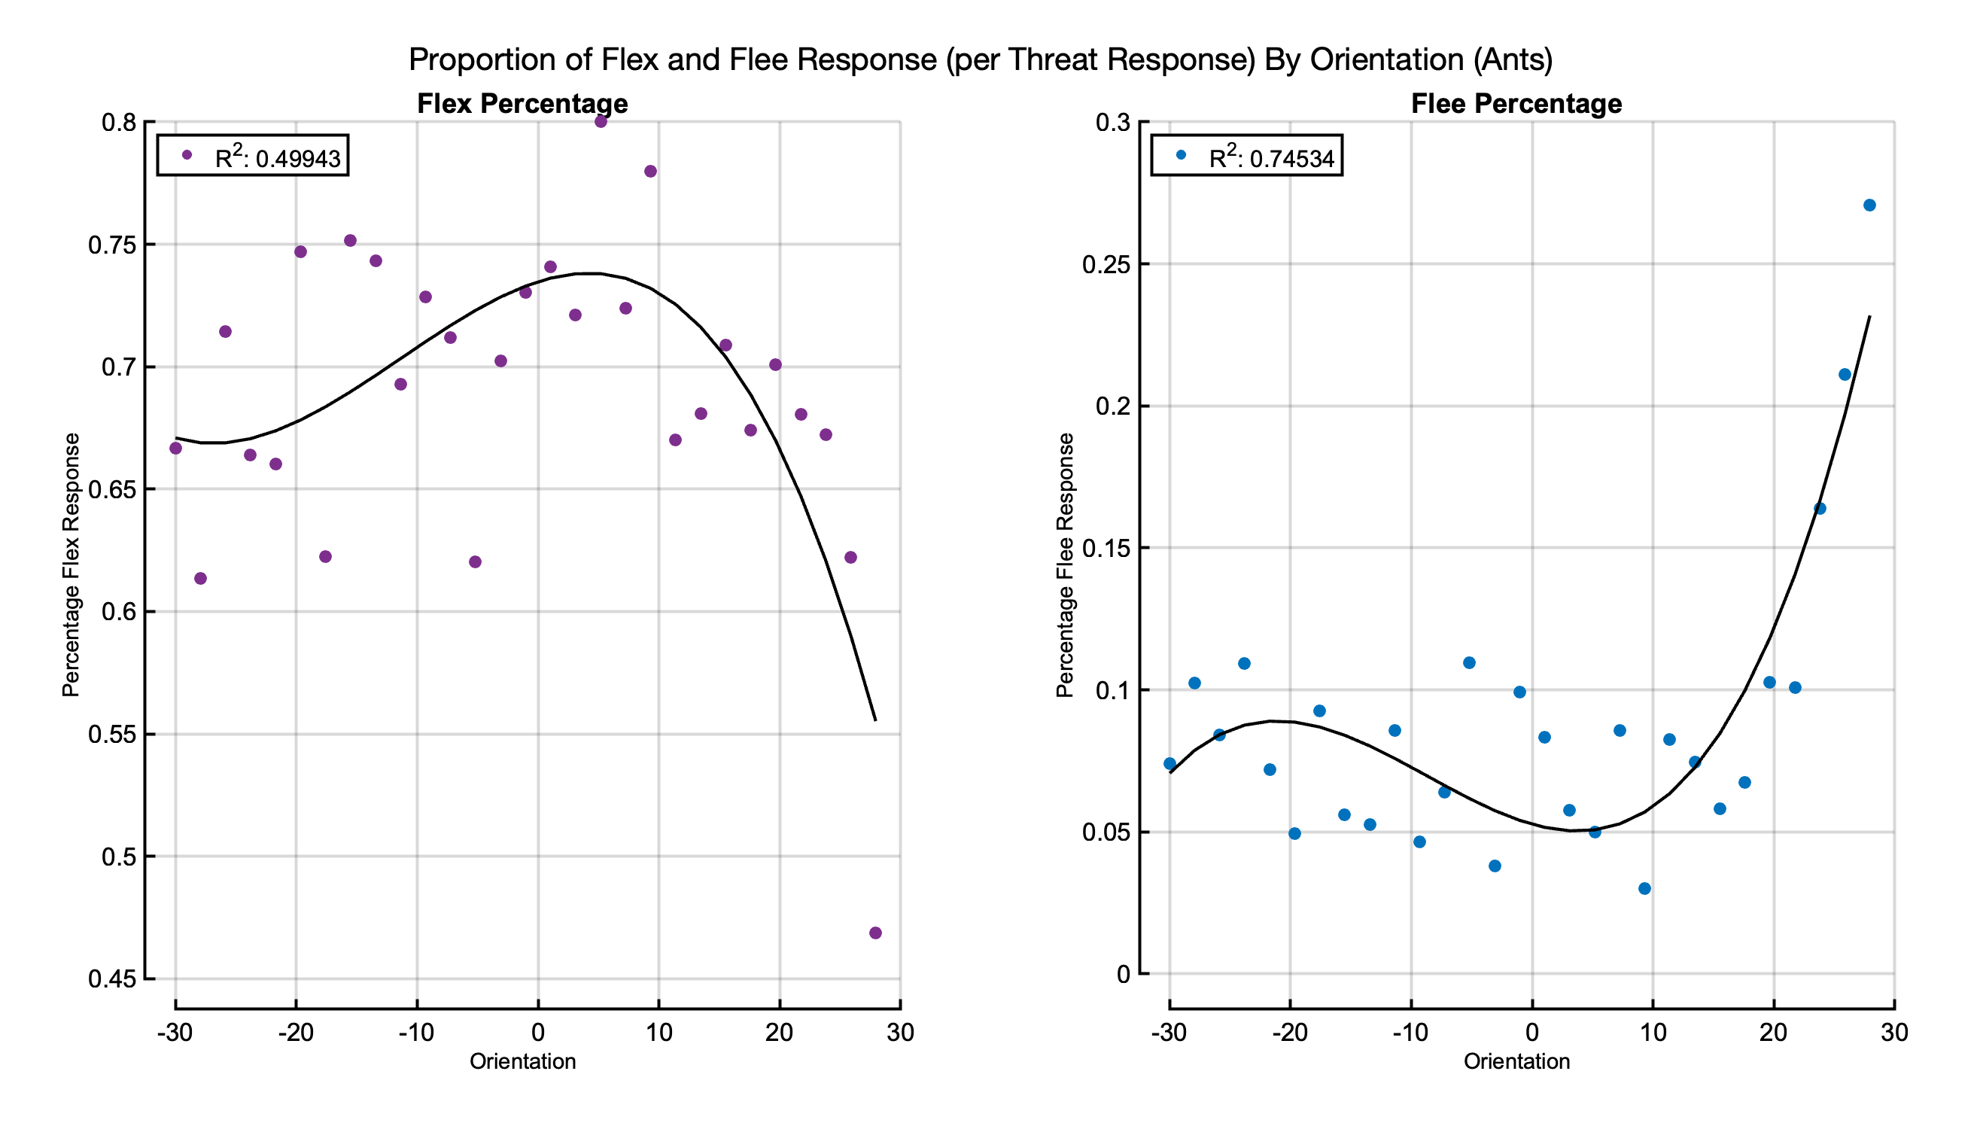
Proportion of Flex Responses Goes Down at Extreme Positive Orientations

Slide 21
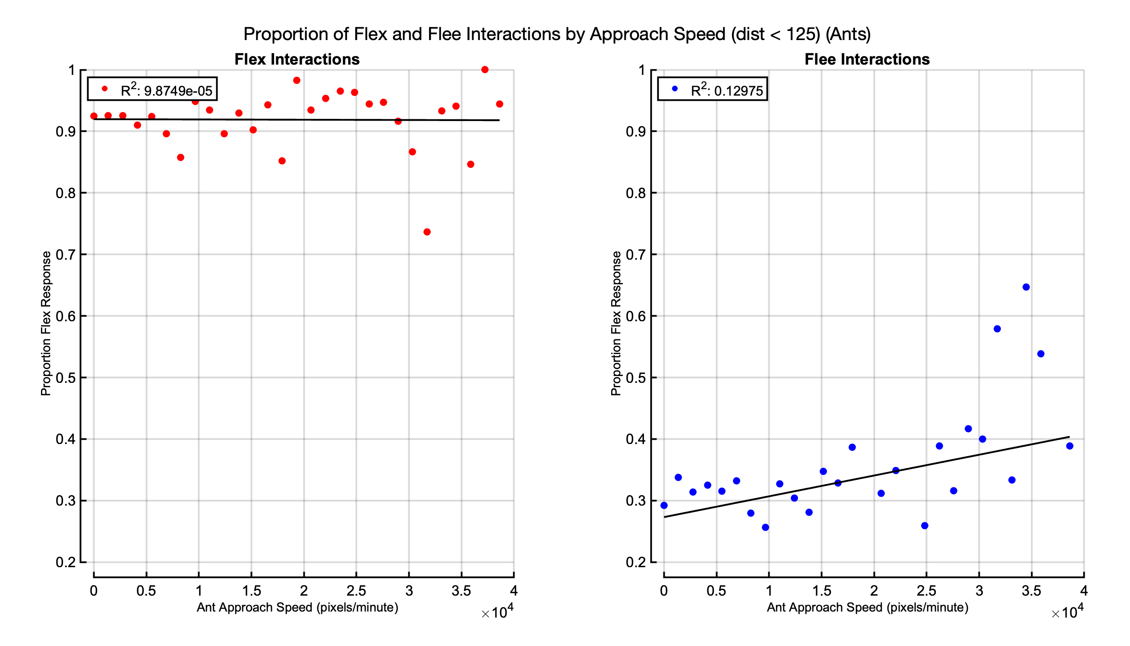
Approach Speed has Little Impact on Flex vs. Flee

Slide 22
Takeaways

Slide 23
Below are a hodge podge of slides I’ve pulled from my previous lab meetings …feel free to use any or figures/icons from any of these as you construct your portion of the meeting

